Slide 1
Banking Data Analysis Using SQL
Presented by-Arjun Menon

Slide 2
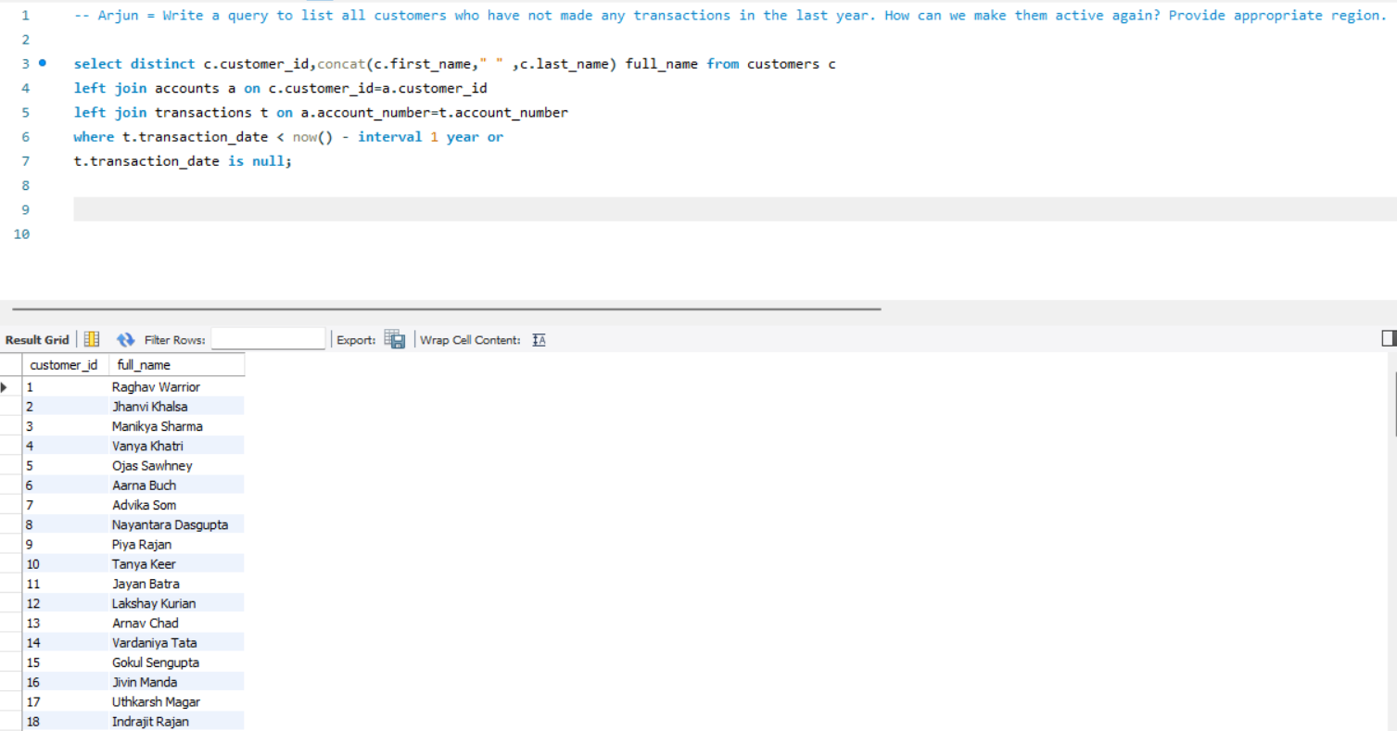
1: Write a query to list all customers who have not made any transactions in the last year. How can we make them active again? Provide appropriate region.

Slide 3
How can we make them active again?
Personalized Communication
Loyalty Programs
Surveys and Feedback
Referral Bonuses
Region-Specific Campaigns

Slide 4
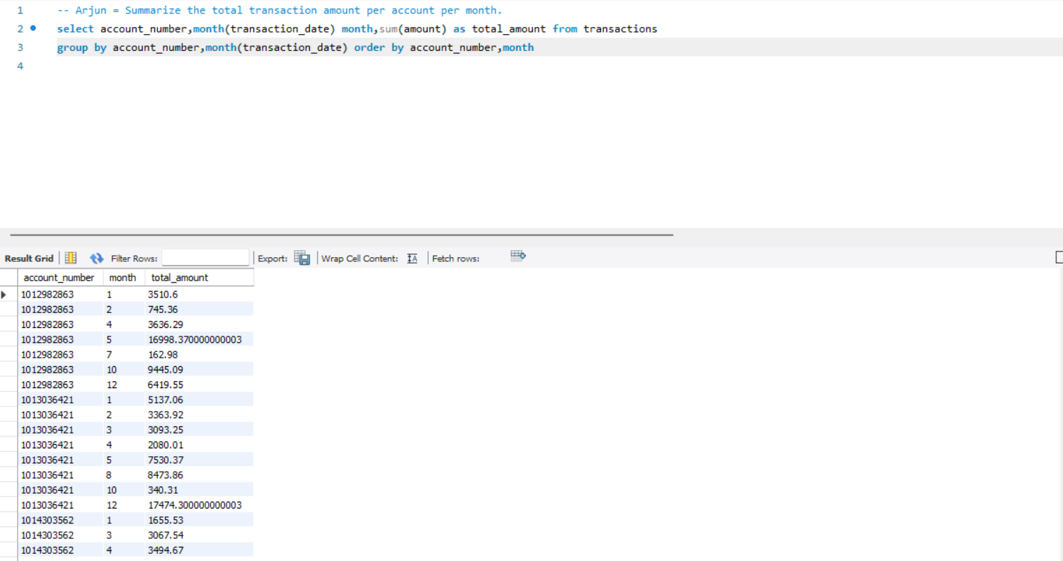
2: Summarize the total transaction amount per account per month.

Slide 5
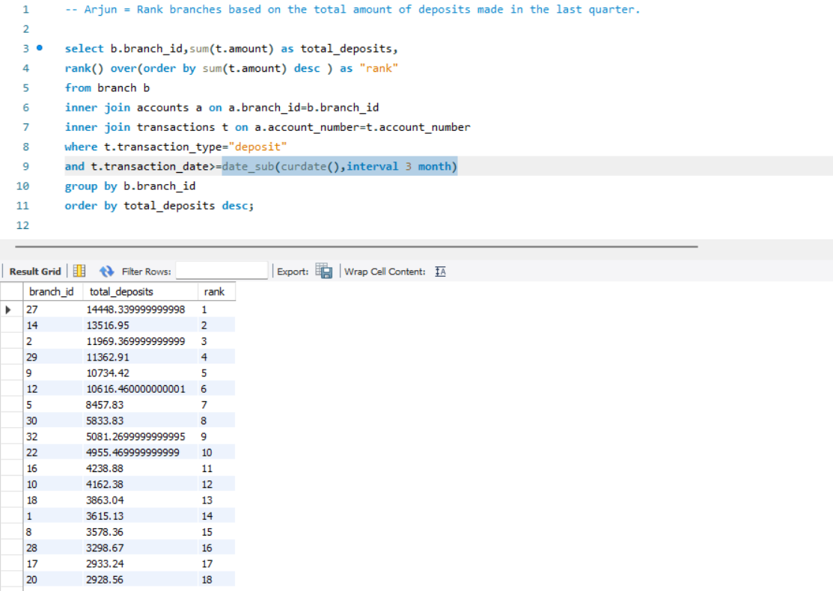
3: Rank branches based on the total amount of deposits made in the last quarter.

Slide 6
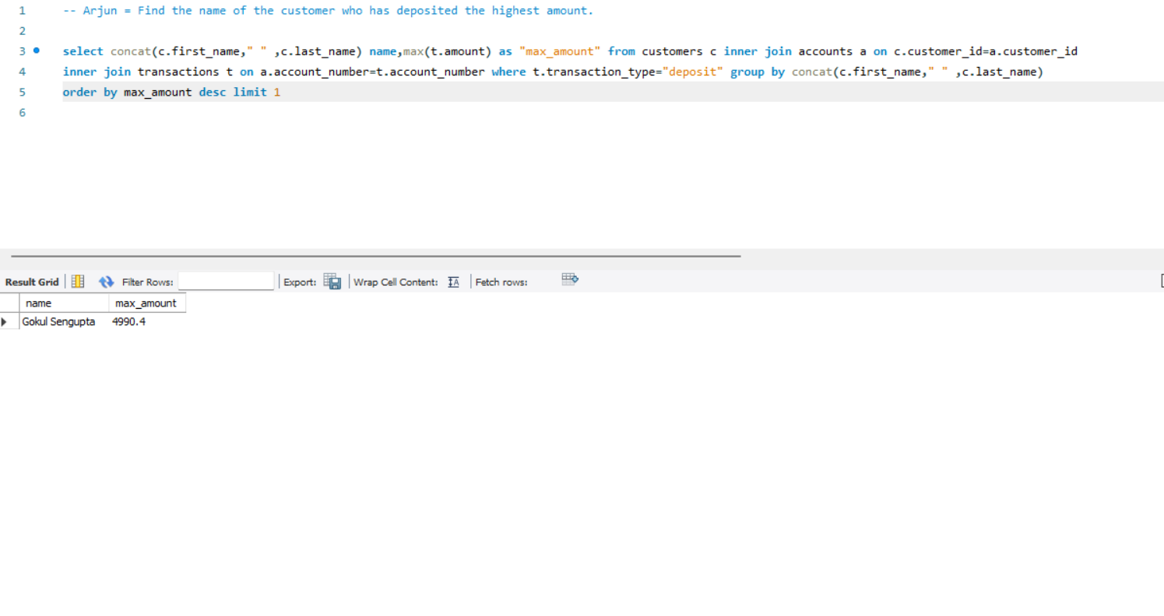
4: Find the name of the customer who has deposited the highest amount.

Slide 7
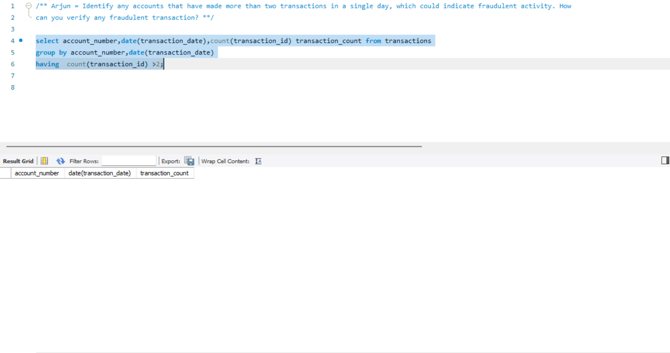
5: Identify any accounts that have made more than two transactions in a single day, which could indicate fraudulent activity.

Slide 8
How can you verify any fraudulent transaction?
Transaction Pattern Analysis
Customer Verification
Review of Transaction Details
Consulting Fraud Detection Systems
Suspension of Account Activity
Legal and Compliance Review

Slide 9
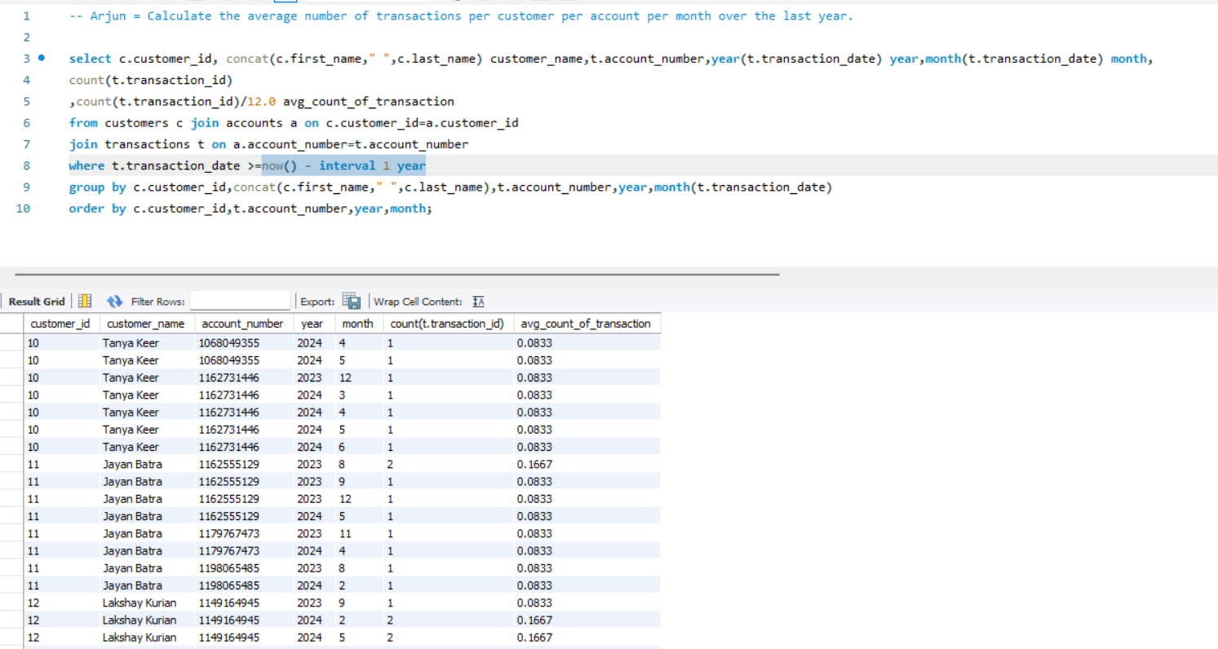
6: Calculate the average number of transactions per customer per account per month over the last year.

Slide 10
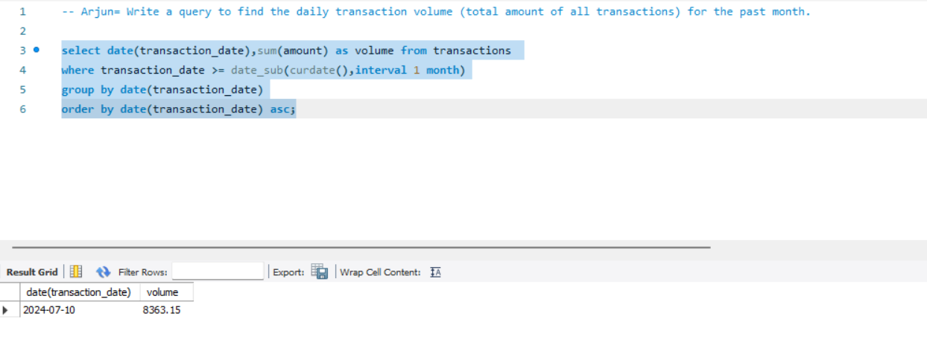
7: Write a query to find the daily transaction volume (total amount of all transactions) for the past month.

Slide 11
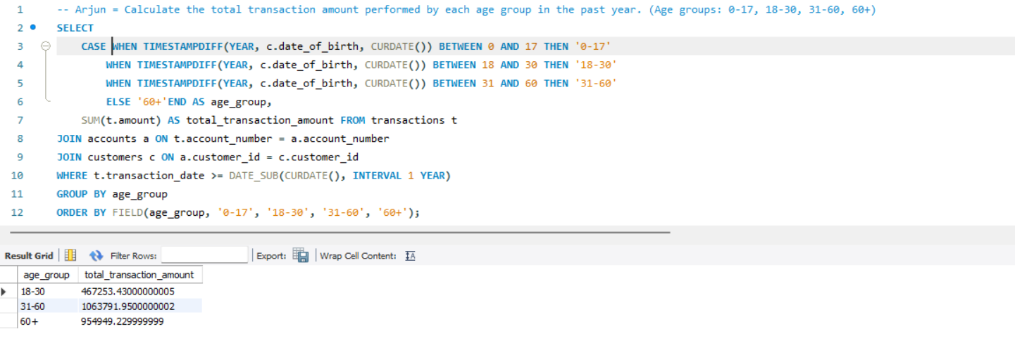
8: Calculate the total transaction amount performed by each age group in the past year. (Age groups: 0-17, 18-30, 31-60, 60+)

Slide 12
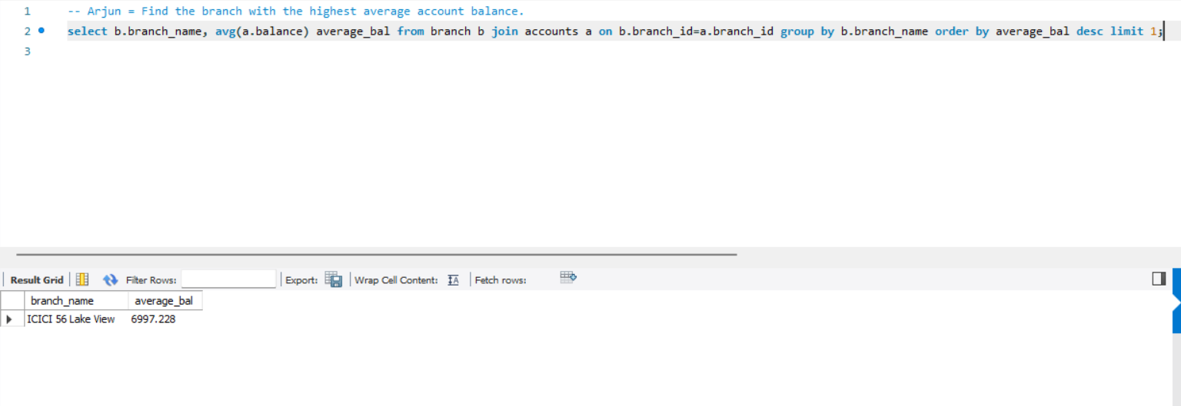
9: Find the branch with the highest average account balance.

Slide 13
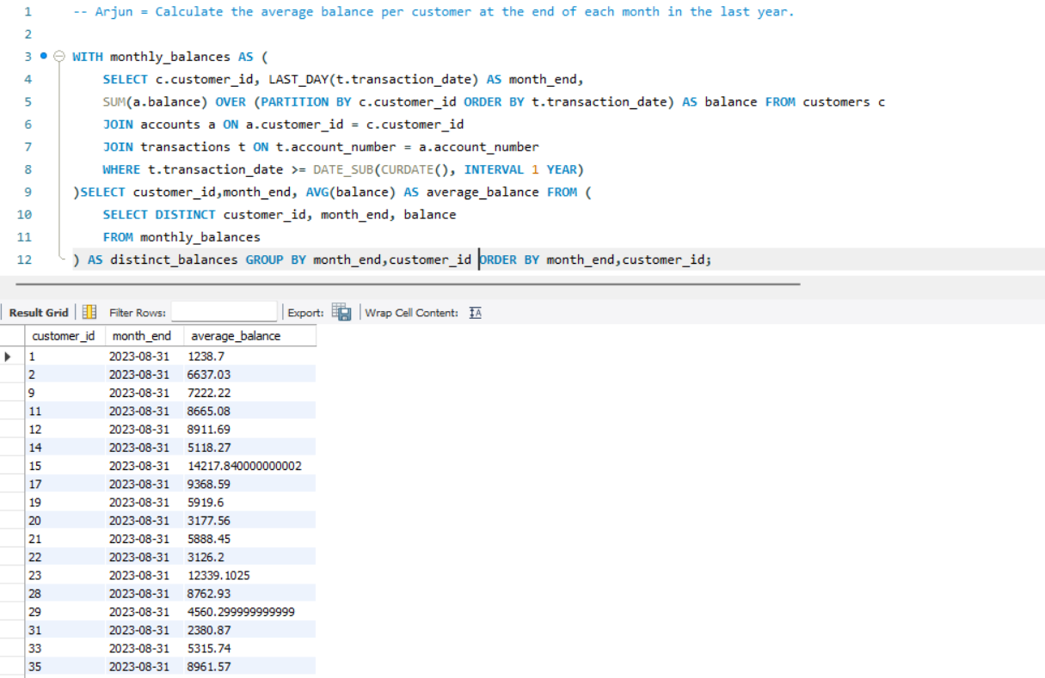
10: Calculate the average balance per customer at the end of each month in the last year.

Slide 14
Conclusion
This presentation provided a comprehensive analysis of banking data using SQL, focusing on key insights and actionable outcomes. We identified customers who have been inactive over the last year and explored strategies to re-engage them, such as personalized communication and loyalty programs. The analysis also highlighted potential fraudulent activities by detecting accounts with unusually high transaction volumes in a single day.
Moreover, we assessed the total transaction amounts across various age groups, calculated average balances per customer monthly, and ranked branches based on deposit activities. This analysis is crucial for improving customer engagement, enhancing fraud detection mechanisms, and optimizing banking operations.
By leveraging these insights, banks can strengthen customer relationships, ensure financial security, and drive growth across regions.

Slide 15
THANK YOU EVERYONE

